Slide 1
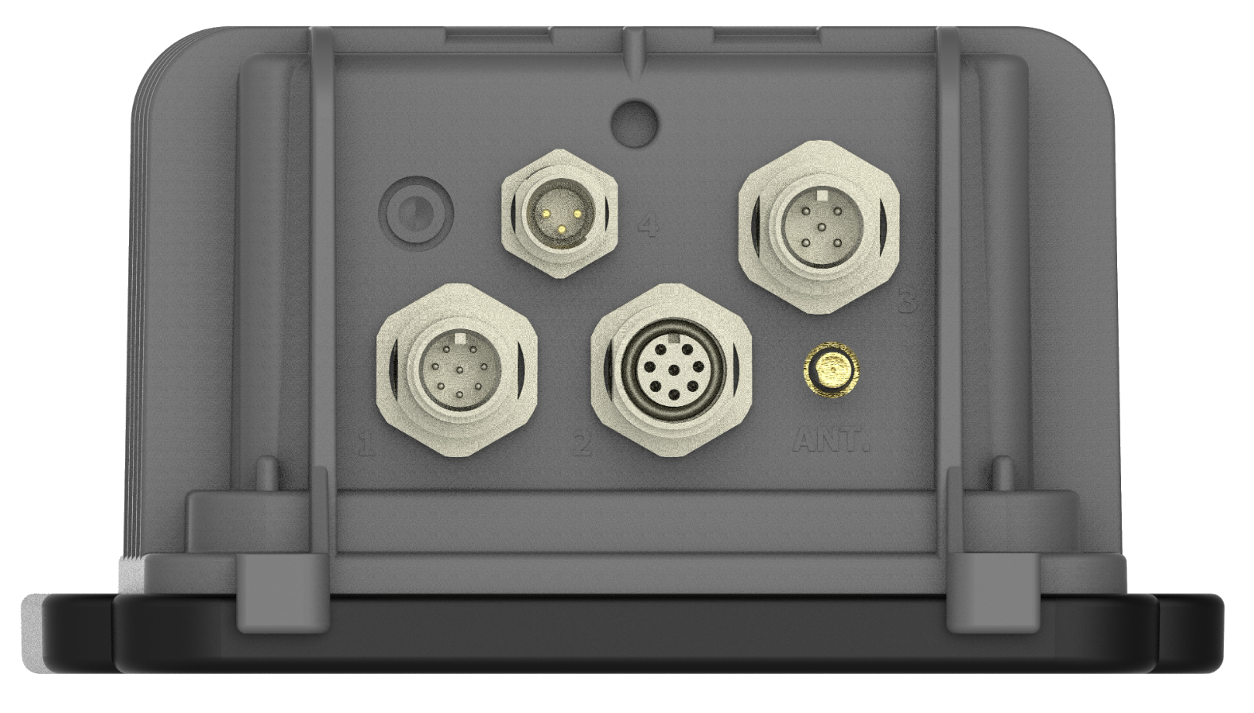
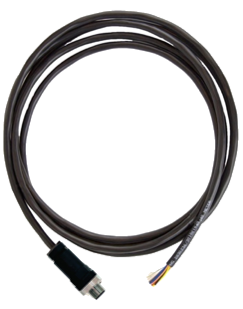

Pinout: Serial Cable Assembly
Model WA00140
For technical support, contact:
support@ayyeka.com
+1 310 876 8040 (US)
+1 437 887 9115 (CA)
+972 2 624 3732 (EMEA)
Panel connector #2
M12 8-pin male
Connect to Wavelet
M12 8-pin male
April 7, 2021
www.ayyeka.com
info@ayyeka.com

Slide 2
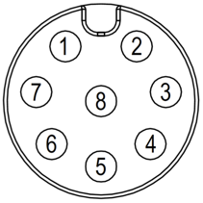
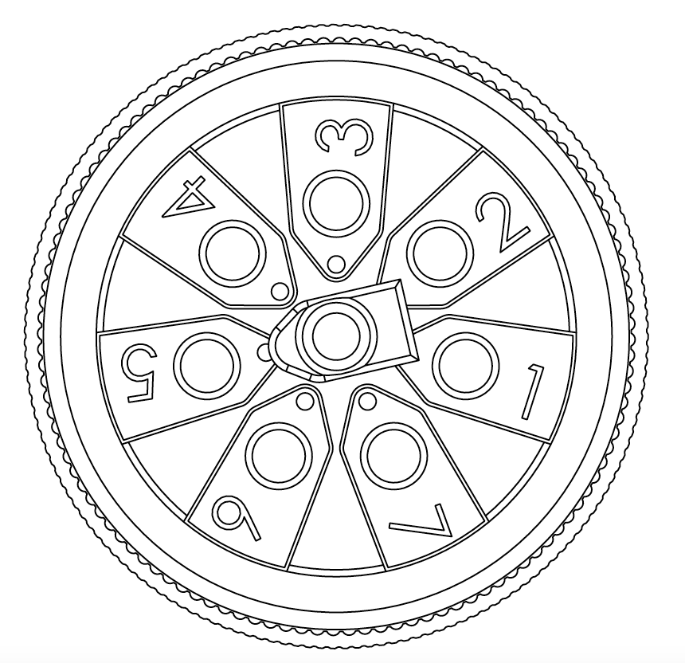
Pinout: Serial Cable Assembly for Wavelet V2 and Wavelet
Model WA00140
WA1111-xx-V2 and WA1111-xx
Connector Pin # | Color | Signal | Pin Assignment
1 | White | RS232 TX | Front | Back
2 | Brown | Wavelet 12V Power Supply #4 (+)
3 | Green | Wavelet 12V Power Supply #3 (+)
4 | Yellow | SDI-12
5 | Gray | RS485 B
6 | Pink | RS485 A
7 | Blue | RS232 RX
8 | Red | Negative (-)
1
2
7
8
3
8
6
5
4
Note: xx represents the different models for US, EU, and SA
www.ayyeka.com
info@ayyeka.com

