Slide 1
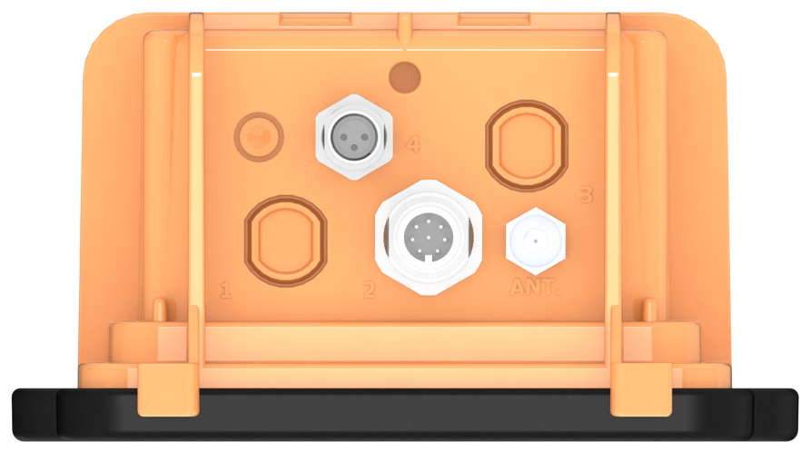
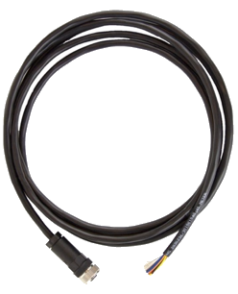

Pinout: Cable Assembly for Wavelet 4R
Model WA00271
For technical support, contact:
support@ayyeka.com
+1 310 876 8040 (US)
+1 437 887 9115 (CA)
+972 2 624 3732 (EMEA)
Panel connector #1
M12 8-pin male
Connect to Wavelet
M12 8-pin female
April 7, 2021
www.ayyeka.com
info@ayyeka.com

Slide 2
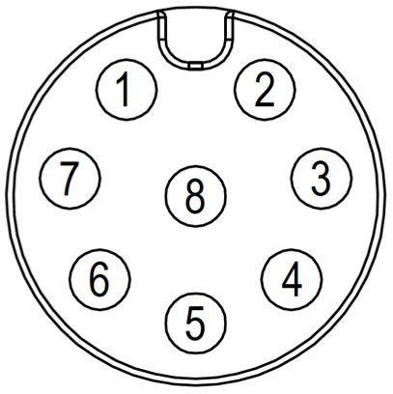
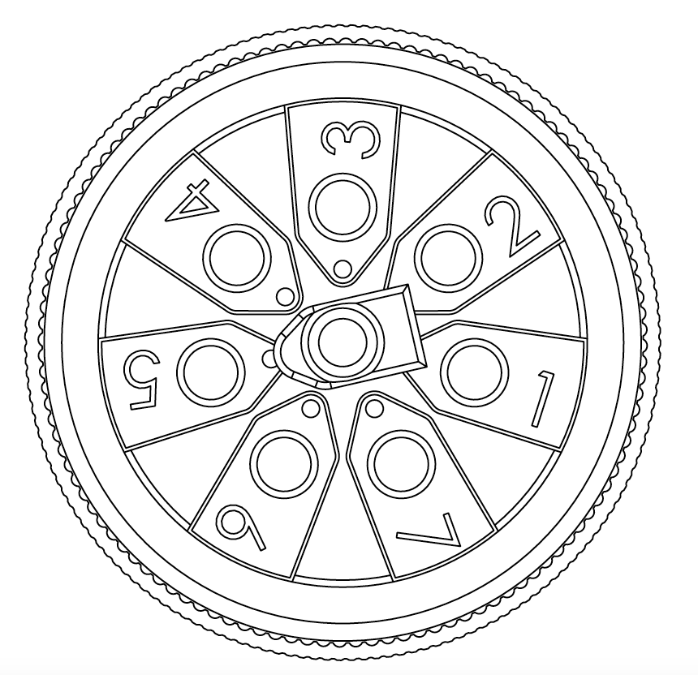
Pinout: Cable Assembly for Wavelet 4R
Model WA00271
WA4000-xx
Connector Pin # | Color | Signal | Pin Assignment
1 | White | 4-20mA or 0-24V Input #1 | Front | Back
2 | Brown | PCNT_0 – pulse counting, edge, periodic, output Dry contact, open drain, 0V or 2.8V (max)
3 | Green | RS485 A and RS232 RX
4 | Yellow | Wavelet 12V Power Supply #1 (+)
5 | Gray | RS485 B and RS232 TX
6 | Pink | PCNT_1 – pulse counting, edge, periodic, output Dry contact, open drain, 0V or 2.8V (max)
7 | Blue | 4-20mA or 0-24V Input #2
8 | Red | GND
2
1
3
8
7
8
4
5
6
Note: xx represents the different models for geographic regions
www.ayyeka.com
info@ayyeka.com

