Slide 1
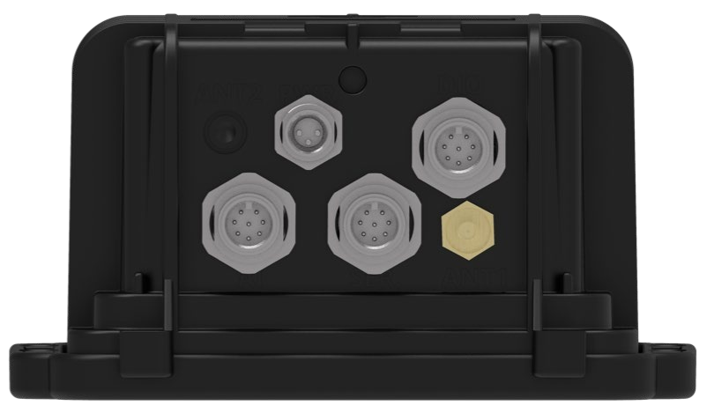
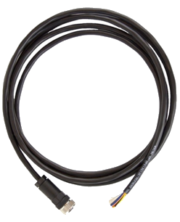

Pinout: Cable Assembly for Wavelet Ex
Model WA00234
For technical support, contact:
support@ayyeka.com
+1 310 876 8040 (US)
+1 437 887 9115 (CA)
+972 2 624 3732 (EMEA)
Panel connector #2
M12 8-pin male
Panel connector #3
M12 8-pin male
Panel connector #1
M12 8-pin male
Connect to Wavelet Ex
M12 8-pin female
April 7, 2021
www.ayyeka.com
info@ayyeka.com

Slide 2
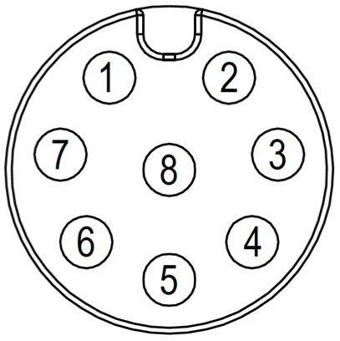
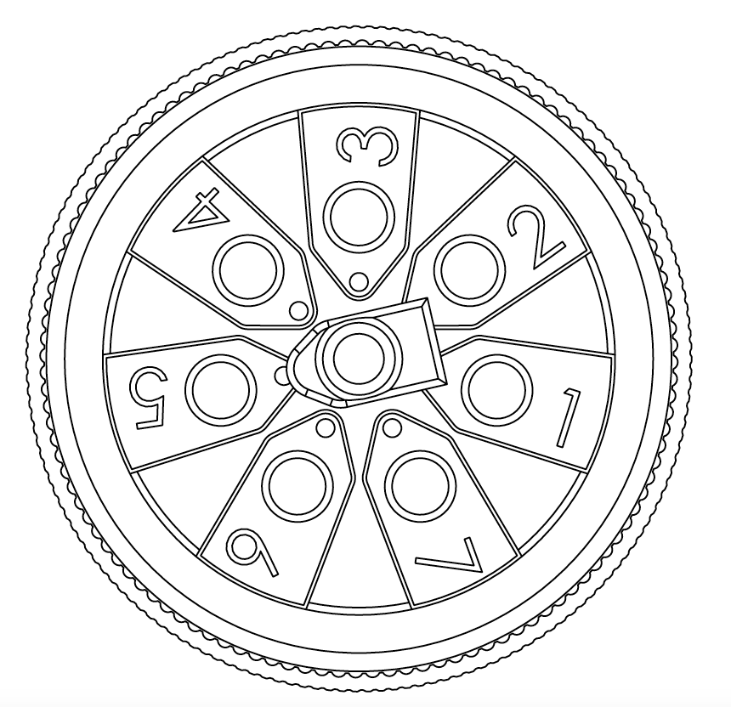
Pinout: Cable Assembly for Wavelet Ex
Model WA00234
WA3888-xx
Connector Pin # | Color | Signal | Pin Assignment
1 | White | 4-20mA or 0-27.5V Input #1* | Front | Back
2 | Brown | PCNT_0 – pulse counting, edge, periodic, output Dry contact, open drain, 0V or 2.8V (max)*
3 | Green | RS485 A
4 | Yellow | Wavelet 12V Power Supply #1 (+)*
5 | Gray | RS485 B
6 | Pink | RS232 RX
7 | Blue | RS232 TX
8 | Red | GND
2
1
3
8
7
8
4
5
6
*Please note that I/O type depends on the port number used on the Wavelet Ex; refer to pinout for WA3888-xx
Note: xx represents the different models for US, EU, and SA
www.ayyeka.com
info@ayyeka.com

