Slide 1
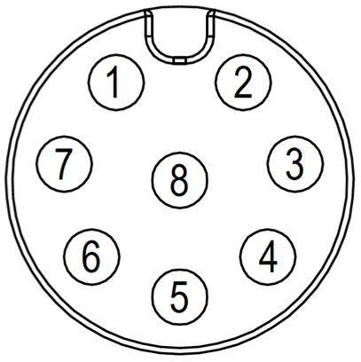

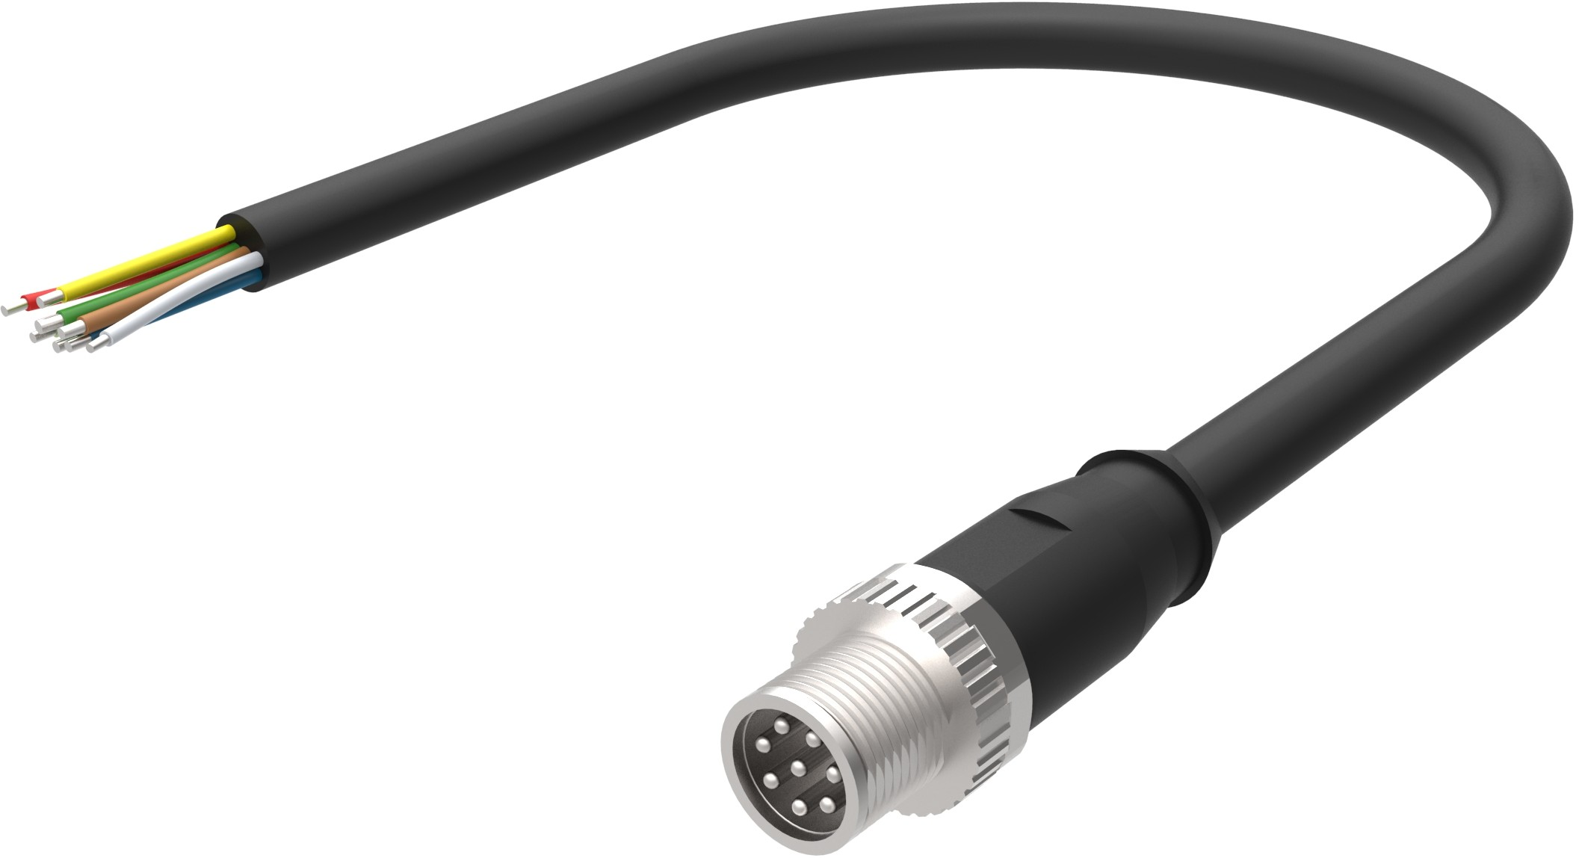

WAVELET 4 – SERIAL CABLE
SERIAL – CONNECTOR #2 – M12 8-PIN MALE
Model WA00140
WA1111-US-V2, WA1111-EU-V2, WA1111-SA-V2
Connector Pin # | Color | Signal | Cable Connector Pin Assignment
1 | White | RS232 TX | Front | Back
2 | Brown | Wavelet 12V Power Supply #4 (+)
3 | Green | Wavelet 12V Power Supply #3 (+)
4 | Yellow | SDI-12
5 | Black or Gray | RS485 B
6 | Orange or Pink | RS485 A
7 | Blue | RS232 RX
8 | Red | GND
2
1
3
7
4
6
Pinout remains unchanged from that of WA1111-US, WA1111-EU, WA1111-SA
www.ayyeka.com
+1 (310) 876-8040 (US)
+31 (40) 209-1001 (EMEA)
info@ayyeka.com

Slide 2
NEED HELP?
For technical support please contact:
support@ayyeka.com
+1 (310) 876-8040 Ext. 3 (US)
+31 (40) 209-1001 Ext. 3 (EMEA)
www.ayyeka.com
+1 (310) 876-8040 (US)
+31 (40) 209-1001 (EMEA)
info@ayyeka.com

